Slide 1
Primary health care center Patient database
K.l.e technological University, hubli
Team members:
Apoorva s malemath
Team number:4A10

Slide 2
Client
Name | Dr. Arun Kumar
Designation | Vector borne disease control officer
Official Address | Health and family welfare office, opposite to Neharu maidan, Manglore, Karnataka, 575001
Contact number | 9448563472

Slide 3
Tasks to be completed
Communication with the client.
Interpreting the problem statement.
Brainstorming the possible solutions for the problem statement.
Implementing the ER model.
Deriving the relational schema.
Attaining Data Dictionary.

Slide 4
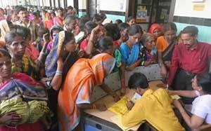
Problem statement
To design a The Primary health care center patient database system is a database management system that uses database technology to construct, maintain and manipulate various kinds of data about a person’s medical history and care across time. The DBMS can track and update all the information of registered patients in the primary care center.
The medical record serves a variety of purposes and is essential to the proper functioning of the medical practice. Especially in today’s complicated health care environment. The medical record is a key instrument used in planning, evaluating, and coordinating patient care.

Slide 5
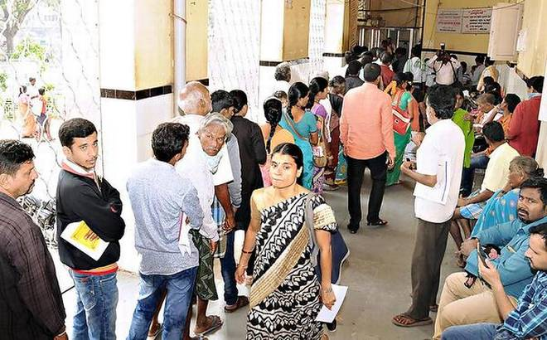
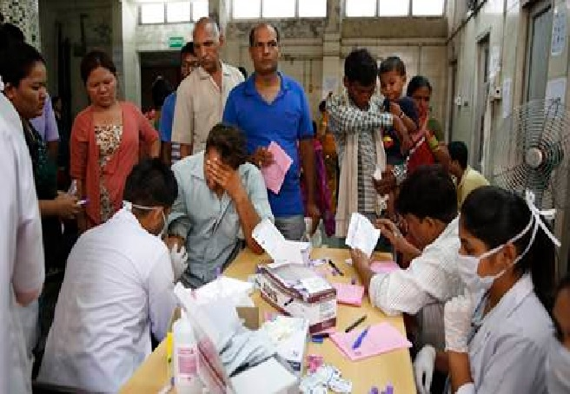
Why is there a need?

Slide 6
Functionalities to be implemented
Medical records are created when a patient receive treatment from a government health professional. Records include the patients:
Personal information
Medical history
Laboratory test results
Medications prescribed
Reports that indicate the results of operations and other medical procedures
Disabilities
Allergies
Insurance
Eligibility for government programs.
Analysis of trends in common diseases.

Slide 7
Entity | Attributes
Patient | Aadhar_no, First_Name, Middle_Name, Last_Name, DOB, Age, Pin_code, Contact_no, Economic_status, Photo
Emergency_Contact | Name, Relationship, Contact_no, Address
Allergy | Substance_name
Disability | Disability_name
Insurance | Insurance_no, Name, Address, Contact_no, Category
Operation | Op_no, Name, Date, Details, File
Disease | Visit_id, Date, Diagnosis_ID, Category, Description
Prescription | Prec_id, Med_name, Quantity, Price, Bill_Amt
Test_Reports | Rep_ID, Rep_name, file
Scheme | Scheme_ID, Name

Slide 8
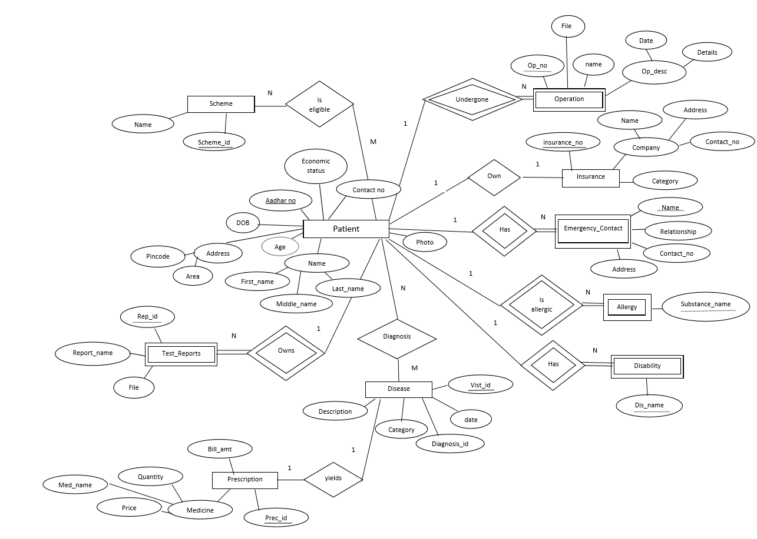
Er model

Slide 9
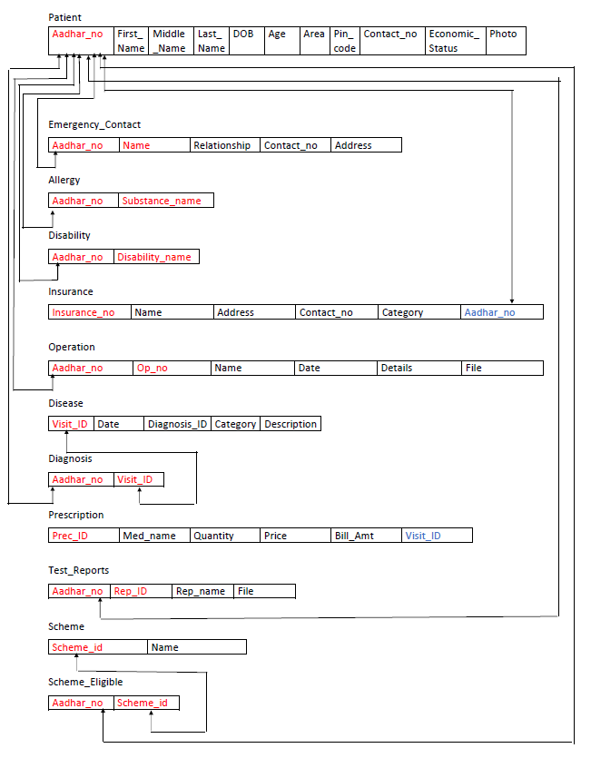
Relational schema

Slide 10
Thank you

